Slide 1
History of Baseball: “The Relative Age Effect”
MSDS 7330 – FALL 2016
DECEMBER 8, 2016
Vishal Ahir, Earl Shaw, Jessica Wheeler
GitHub Repository:
https://github.com/jessicawheeler/BaseballAndRAE

Slide 2
“The Relative Age Effect”
Various studies on RAE claim that in a league sport, those that are the eldest due to age cut-offs tend to perform better and are more likely to play professionally and earn higher wages.
First study on RAE came out in 1985 on hockey players.
Found that NHL players of the early 1980s were 4 times more likely to be born in the first 3 months of the year versus the last 3 months.

Slide 3
“The Relative Age Effect”
http://www.slate.com/articles/sports/sports_nut/2008/04/the_boys_of_late_summer.html
Big Idea: Players born in August in the United States have a greater chance of playing professional baseball considering July 31st represents the age cutoff used by the majority of non-school affiliated leagues
Last study looked at the baseball data up until 2005 and found that RAE was still pronounced in US born baseball players.

Slide 4
Example:
Todd is born August 2, 1991, while Jack is born July 15, 1992
They start playing club baseball in July 2005 in the 13-14 year old league
With a July 31st cutoff, Jack turned 13 on July 15, 2005 just in time to make the cutoff, while Todd turned 13 on August 2, 2004, close to one year prior
This additional year could conceivably give Todd an advantage among his peers

Slide 5
Explanation
Coaches confuse maturity with ability and give more opportunities to excel to the older players of the group.
These players were chosen to play in an all-star team where they got more practice and actually became better.
Placed in a position to improve more and more year after year.
12 full months make a tremendous difference when it comes to youth ages.

Slide 6
Research Objective
Our aim is to determine whether or not the relative age effect holds for a sample of major league baseball players
Additionally, while it may be observed that players born in August have a greater chance of playing professional baseball, our interest also lies in determining if an August birthdate leads to superior playing performance and/or greater financial rewards relative to peers, based on key metrics available in the data
Particularly, do players with August birthdays:
Bat better?
Pitch better?
Make more money?

Slide 7
Data
Source: www.kaggle.com → “The History of Baseball” Author: Sean Laham
The data set contains complete Major League Baseball game and player related statistics
The data was provided in a variety of separate files, e.g. “batting.csv”, “fielding.csv”, “team.csv”, etc.
Microsoft Excel and MySQL Workbench were used to load the data and perform all analysis
Several scripts were written in MySQL to load the data and join tables for a more robust analysis

Slide 8
Data was restricted to years 2013-2015 from the following files:
“salary.csv” – contains salary related information for each player 731.42KB
“player.csv” – contains personal and demographic information for each player such as, birthdate, full name, etc. 920.9KB
“batting.csv” – contains batting information on each player, e.g. at bats, runs, hits, etc. 2.02MB
“pitching.csv” – contains pitching information for each player, e.g. strikeouts, wins, losses, etc. 1.4MB

Slide 9
Operating System and Database Details
Computer: Mac
Operating System: OS X El Capitan
CPU: 3.06 GHz Intel Core i3
Memory: 12GB
Database Server: MySQL community server version 5.7.16
Database GUI: MySQL Workbench 6.3.8 build 1228 CE (64-bit) Community
Database size estimate: 11.4 MiB

Slide 10
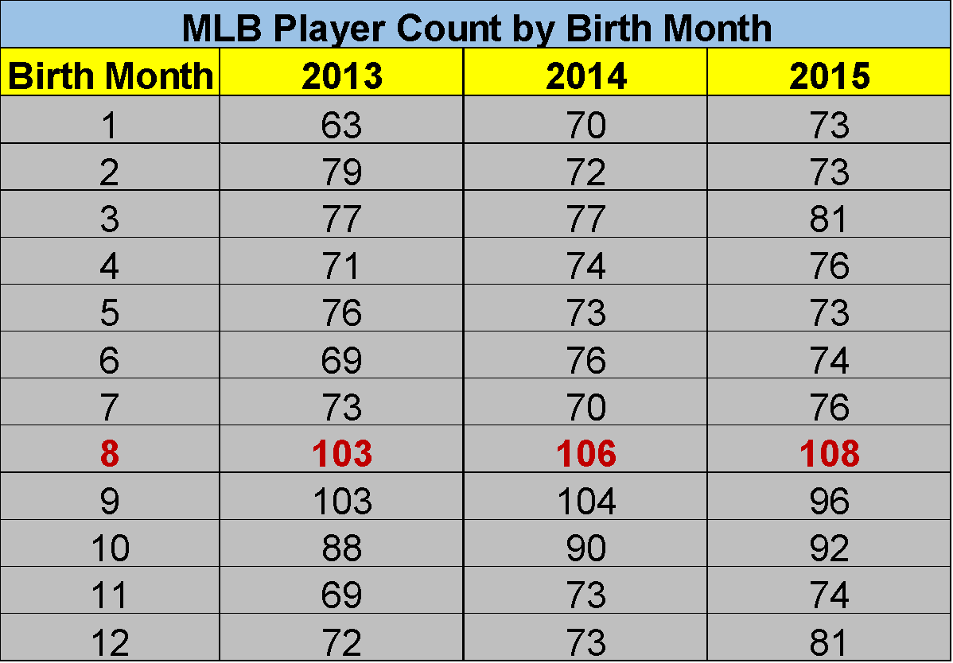
The Effect of Birth Month -
Is RAE Still Present?
Based on the sample of MLB players from 2013-2015 (table at right contains US players only), more players were born in August than any other month, highlighting the presence of the “Relative Age Effect”

Slide 11
Pitching Performance
Using the Pitching and Player file, we have tried to rank top 5 players for various parameters like
Wins
Runs
StrikeOut
Next we will display charts with respect to these analysis:

Slide 12
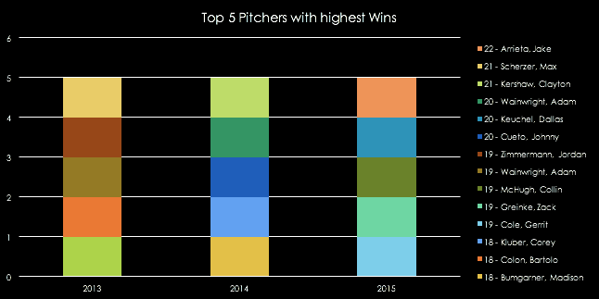
Pitching Performance - Wins
Top 5 pitchers in terms of Wins for last 3 years:

Slide 13
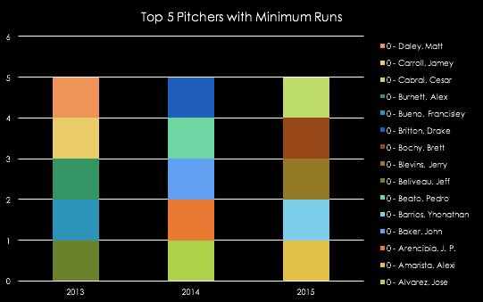
Pitching Performance - Runs
Top 5 pitchers in terms of Runs for last 3 years

Slide 14
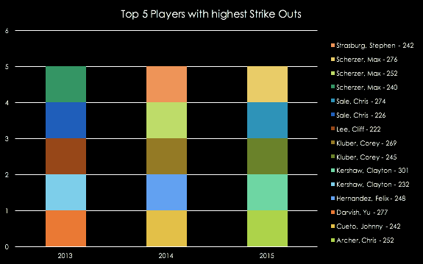
Pitching Performance - Strikeouts
Top 5 pitchers in terms of Strikeouts for last 3 years

Slide 15

RAE for Pitching Players
Below is the chart comparing birth month for top 5 players in terms of runs, wins and strikeouts for 2013-2015.
We clearly see March has maximum number of players followed by a tie between July and August.

Slide 16
Batting Performance
Based on several summary measures provided below, it appears that US players born in August hold a very minimal statistical edge over those born in other months
This slight edge exists across all metrics for available years with the exception of average triples per player and 2015 batting average
It appears the most significant advantage, in absolute terms, occurs for the number of “At Bats”, with players born in August averaging ~13 more at bats than players born in other months
This variance could be a result of numerous factors aside from birth month, but more research and analysis is warranted to more accurately determine

Slide 17
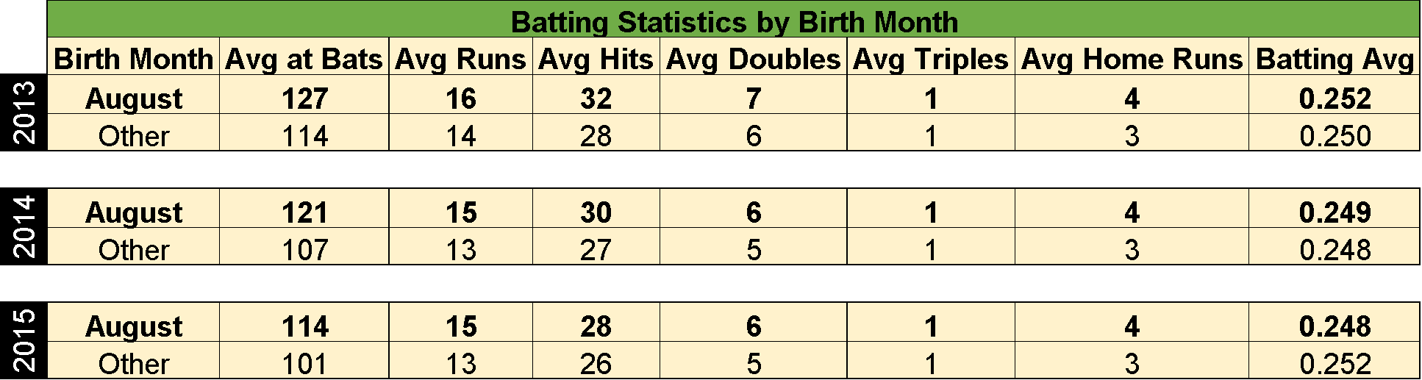

Slide 18
Salary Comparison
Top 5 MLB Salaries and Birth Month in 2013-2015
 | 2013 | Month Born | 2014 | Month Born | 2015 | Month Born
1 | $29 mil | July | $26 mil | October | $32.6 mil | March
2 | $25 mil | August | $25 mil - (2) | November, August | $28 mil | February
3 | 24.6 mil | December | $24 mil - (2) | May, October | $25 mil - (2) | October, November
4 | 24.2 mil | July | $23 mil - (3) | April, July, January | 24.9 mil | April
5 | 23.1 mil | April | $22.8 mil | April | $24 mil - (3) | January, October, May
Notes:
This table shows top 5 salary ranges for 2013 - 2015.
Table on next slide shows counts for each month and results.

Slide 19
Top 5 Salary Counts
January | 2
February | 1
March | 1
April | 4
May | 2
June | 0
July | 3
August | 2
September | 0
October | 4
November | 2
December | 1
Births in April and October had the highest counts for births of Players with the Top 5 highest salaries in 2013-2015.
No evidence of Relative Age Effect when it comes to highest salaries.

Slide 20
Summary
RAE is seen overall in 2013-2015 in player counts.
RAE in Batting is not significant overall.
→ Players born in August tend to have more “at bats” but this could be due to other things.
Some evidence of RAE in Pitching
→ highest count was March then August and September.
No RAE seen in top 5 salaries from 2013-2015.

Slide 21
Final Thoughts and Questions
Since league cut-off dates were changed to April 30 in 2005, we may see a dilution of the August birthdates and possibly a shift to May birth dates in the future.
Interesting to see if RAE is present in the future given the current publications and research → Will coaches/players/parents realize the effects of the relative age effect and act differently?

